Slide 1


NSOP 2024
IPR #6
Air Force ROTC Detachment 842
The University of Texas at San Antonio
C/Llanas, C/Parry, & C/Griffin
12 Aug 24

Slide 2


Overview
Finalized NSOP Schedule
Leads/Volunteers
Rooms (Reserved)
Logistics
Summary
Air Force ROTC Detachment 842 • We Build Exceptional Officers • The University of Texas at San Antonio

Slide 3
NSOP Schedules
Aug 22nd – Main Auditorium (Cadre Led):
0700-0755: Volunteers Arrive/Set-Up
0800-0900: In-Processing
0905-0920: Commander’s Introduction/Intent
0925-1140: Cadre Introductions/Paperwork/Wings Breakdown
1145-1200: Questions for Cadre
1200: Prospects Dismissed
1205-1300: Volunteers Clean-Up
Aug 23rd – Main Auditorium (Cadet Led):
0700-0755: Volunteers Arrive/Set-Up
0800-0900: In-Processing/Check-In
Main Auditorium: Flight Time/Introductions
0900-0910: Wrap Up Flight Time/Transition To Rotations
0915-1140: Group Rotations
1145-1155: Wrap Up Rotations/Transition To Main Auditorium
1200-1300: Club/Wingstaff Introductions (8 min. max)
1300: Prospects Dismissed
1305-1400: Volunteers Clean-Up
Air Force ROTC Detachment 842 • We Build Exceptional Officers • The University of Texas at San Antonio

Slide 4
Group Rotations
0915 – 1000:
Groups A/B/C:
Room 1.126 – GLP/Waiting
Room 1.120 – Sports Physicals if needed
Groups D/W/X: Room 1.124 – LRS
Groups Y/Z: Upstairs Outside Platform – Tour
1005 – 1050:
Groups Y/Z:
Room 1.126 – GLP/Waiting
Room 1.120 – Sports Physicals if needed
Groups A/B/C: Room 1.124 – LRS
Groups D/W/X: Upstairs Outside Platform – Tour
1055 – 1140:
Groups D/W/X:
Room 1.126 – GLP/Waiting
Room 1.120 – Sports Physicals if needed
Groups Y/Z: Room 1.124 – LRS
Groups A/B/C: Upstairs Outside Platform – Tour
Groups A/B/C Guide: C/Vallor
Groups D/W/X Guide: C/Branson
Groups Y/Z Guide: C/Superales
Air Force ROTC Detachment 842 • We Build Exceptional Officers • The University of Texas at San Antonio

Slide 5
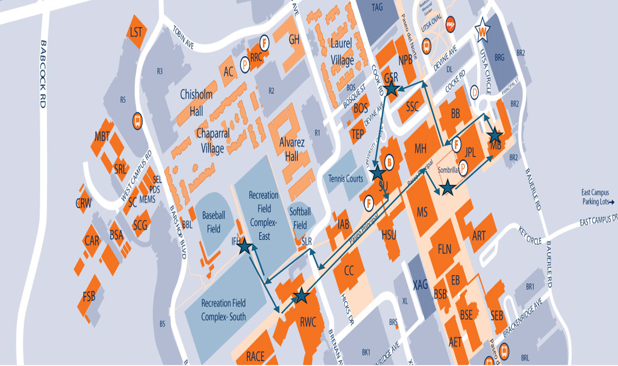
Campus Tour
Tour Directions:
Main Building -> Detachment -> Student Union -> Rec Fields -> Rec Center -> Sombrilla -> Main Building
Air Force ROTC Detachment 842 • We Build Exceptional Officers • The University of Texas at San Antonio

Slide 6
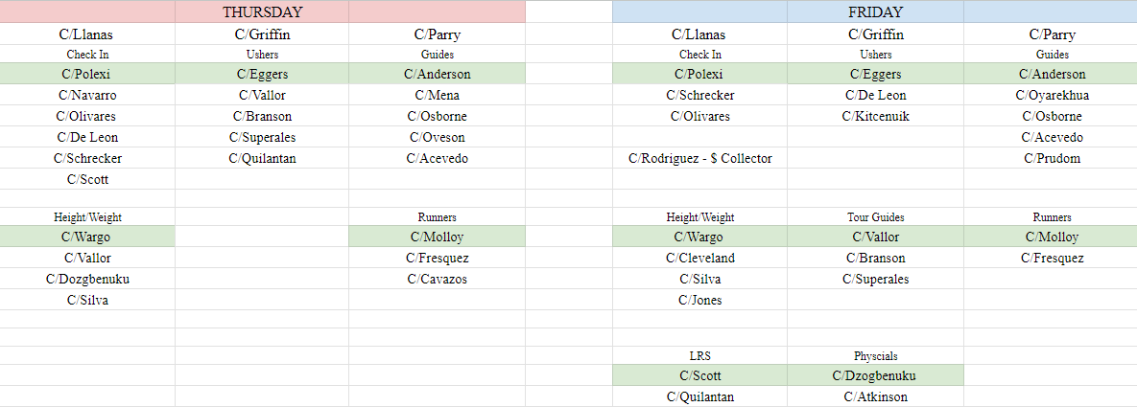
Leads/Volunteers
Air Force ROTC Detachment 842 • We Build Exceptional Officers • The University of Texas at San Antonio

Slide 7
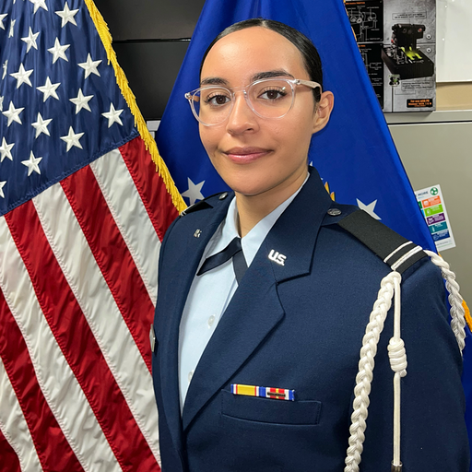
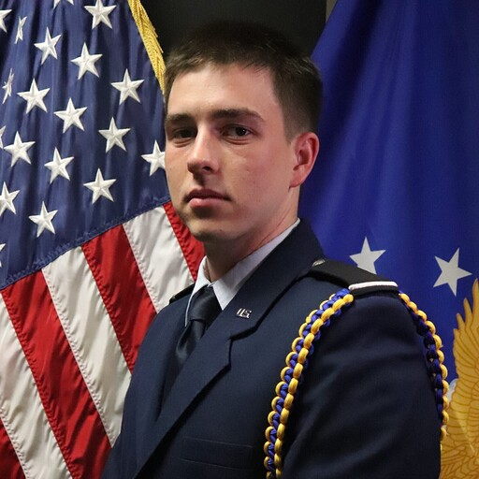
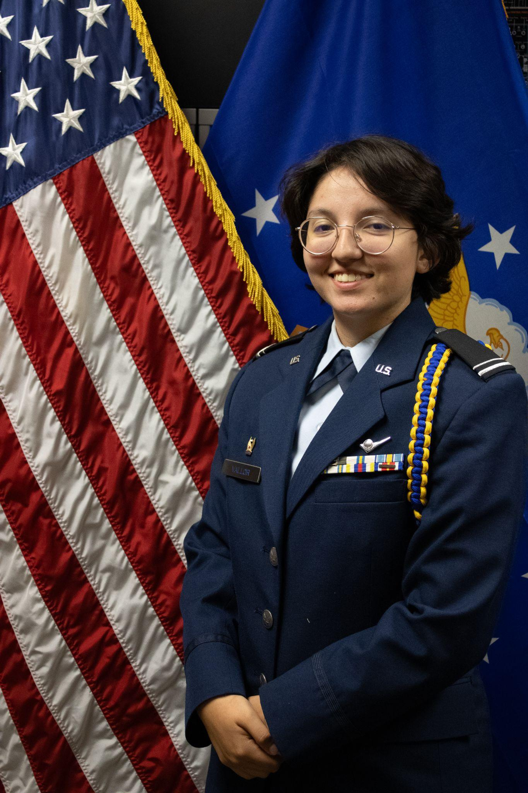
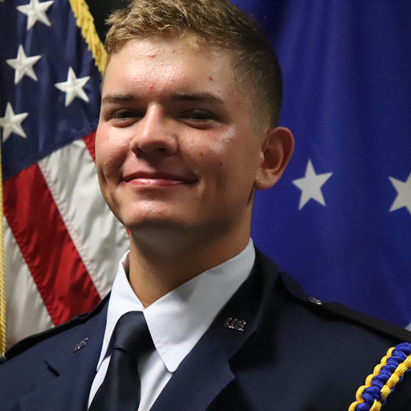
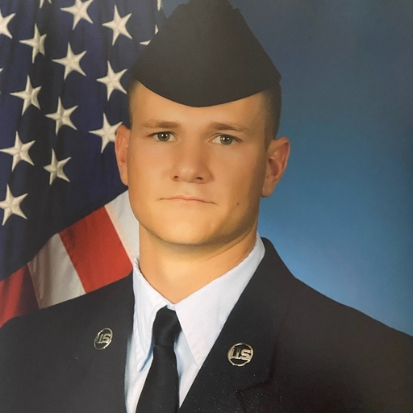
Club/Wingstaff Representatives
Booster: C/Rodriguez
AAS: C/Fanning
Honor Guard: C/Gibson
Victory: C/Graschel
i5: C/Fanning
Silver Wings: C/Kiang
Cadet Colonel Shelby Schrecker
Wing Commander
Cadet Colonel Joshua Davidson
Chief of Staff
Cadet Lt. Colonel Mary Vallor
Deputy Commander of Operations
Cadet Lt. Colonel Cody Funke
Deputy Commander of Combat Support
Cadet Lt. Colonel Connor Griffin
Inspector General
Air Force ROTC Detachment 842 • We Build Exceptional Officers • The University of Texas at San Antonio

Slide 8
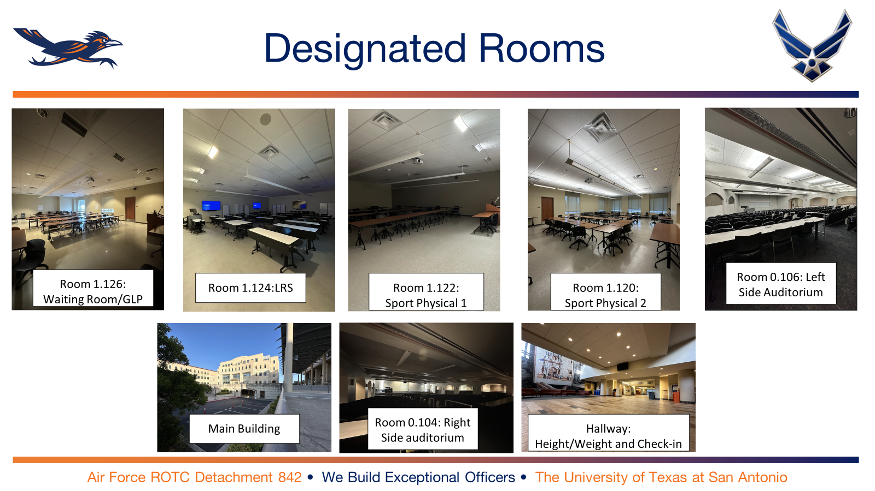
Rooms to Reserve

Slide 9
Logistics
Updates
Snacks - 40 fruit snacks, 32 snack bars
Waters - 160
Wristbands - R, P, G, Y
First Aid Kit
Signs - Directional (2), Height and weight (2), Physical (1), LRS (1) QR codes (2)
Uniforms - Ordered
GLPs - 10 copies
Paperwork - Schedule of group rotations (11) , Extra physicals
Radios
Chairs and Tables for check-in
Air Force ROTC Detachment 842 • We Build Exceptional Officers • The University of Texas at San Antonio

Slide 10
Summary
Finalized NSOP Schedule
Leads/Volunteers
Rooms (Reserved)
Logistics
Summary
Air Force ROTC Detachment 842 • We Build Exceptional Officers • The University of Texas at San Antonio

Slide 11
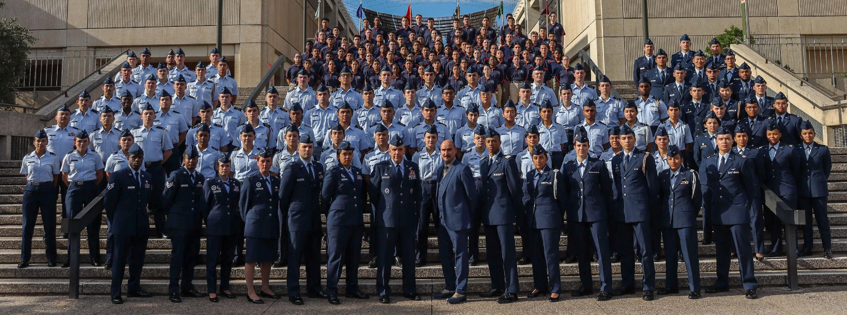
Air Force ROTC Detachment 842
The University of Texas at San Antonio
Det 842 – Best in Blue

